Slide 1
De wereld na corona Denken in scenario’s voor logistieke ondernemers op Lage Weide
Februari 2021
door Albert Jan Swart

Slide 2
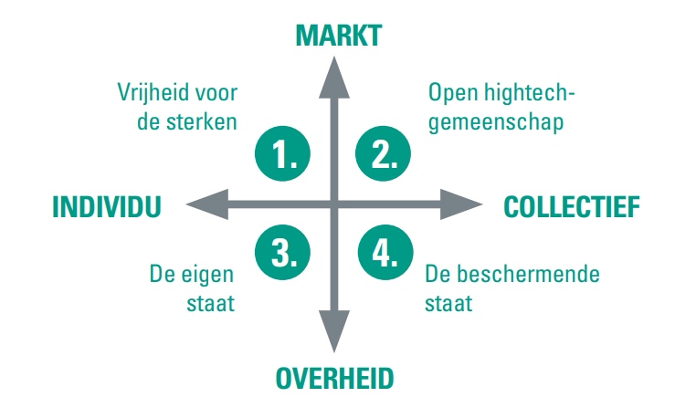
Nederland na corona in vier scenario’s

Slide 3
Sector Transport en Logistiek na corona
1. Vrijheid voor de sterken
2. Open high-tech gemeenschap
Consolidatie
Grote bedrijven met marktmacht
Verdere globalisering
Duurzame transitie tot stilstand
Familiebedrijven spelen grote rol
Samenwerking in de keten is sleutel tot innovatie
Uitwisseling van data leidt tot efficiënte ketens
Duurzaamheid vanuit intrinsieke motivatie van producenten én consumenten
Markt stuurt
Individualisme
Collectiviteit
3. De eigen staat
4. De beschermende staat
Protectionisme beperkt internationaal transport
Distributiecentra worden fabrieken
Weinig samenwerking door korte termijn- visie en wantrouwen t.a.v. delen van data
Overheid neemt regie, bijv. rond duurzaamheid
Ketens kritische goederen (farma) genationaliseerd
Interne markt EU belangrijk, modal split
Logistiek georganiseerd rondom circulariteit
Overheid stuurt

Slide 4
Poll - Welk scenario hoopt u dat uitkomt?

Slide 5
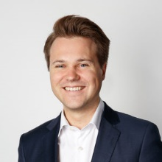
Dank voor uw aandacht!
Lees ook:
Nederland na corona in vier scenario’s
Lange weg naar herstel
Albert Jan Swart
Sectoreconoom Transport & Logistiek
ABN AMRO Sector Advisory
Disclaimer
This document has been prepared by ABN AMRO. It is solely intended to provide financial and general information on the sector developments in the Netherlands. The information in this document is strictly proprietary and is being supplied to you solely for your information. It may not (in whole or in part) be reproduced, distributed or passed to a third party or used for any other purposes than stated above. This document is informative in nature and does not constitute an offer of securities to the public, nor a solicitation to make such an offer.
No reliance may be placed for any purposes whatsoever on the information, opinions, forecasts and assumptions contained in the document or on its completeness, accuracy or fairness. No representation or warranty, express or implied, is given by or on behalf of ABN AMRO, or any of its directors, officers, agents, affiliates, group companies, or employees as to the accuracy or completeness of the information contained in this document and no liability is accepted for any loss, arising, directly or indirectly, from any use of such information. The views and opinions expressed herein may be subject to change at any given time and ABN AMRO is under no obligation to update the information contained in this document after the date thereof.
Before investing in any product of ABN AMRO Bank N.V., you should obtain information on various financial and other risks and any possible restrictions that you and your investments activities may encounter under applicable laws and regulations. If, after reading this document, you consider investing in a product, you are advised to discuss such an investment with your relationship manager or personal advisor and check whether the relevant product –considering the risks involved- is appropriate within your investment activities. The value of your investments may fluctuate. Past performance is no guarantee for future returns. ABN AMRO reserves the right to make amendments to this material.
© ABN AMRO, 2021

